Slide 1


SMART INDIA HACKATHON 2025
TITLE PAGE
Problem Statement ID –25024
Problem Statement Title- Comprehensive Cloud-Based Practice Management & Nutrient Analysis Software for Ayurvedic Dietitians, Tailored for Ayurveda-Focused Diet Plan.
Theme- HEALTHTECH
PS Category- Software
Team ID-
Team Name (NOVASTRA)

Slide 2
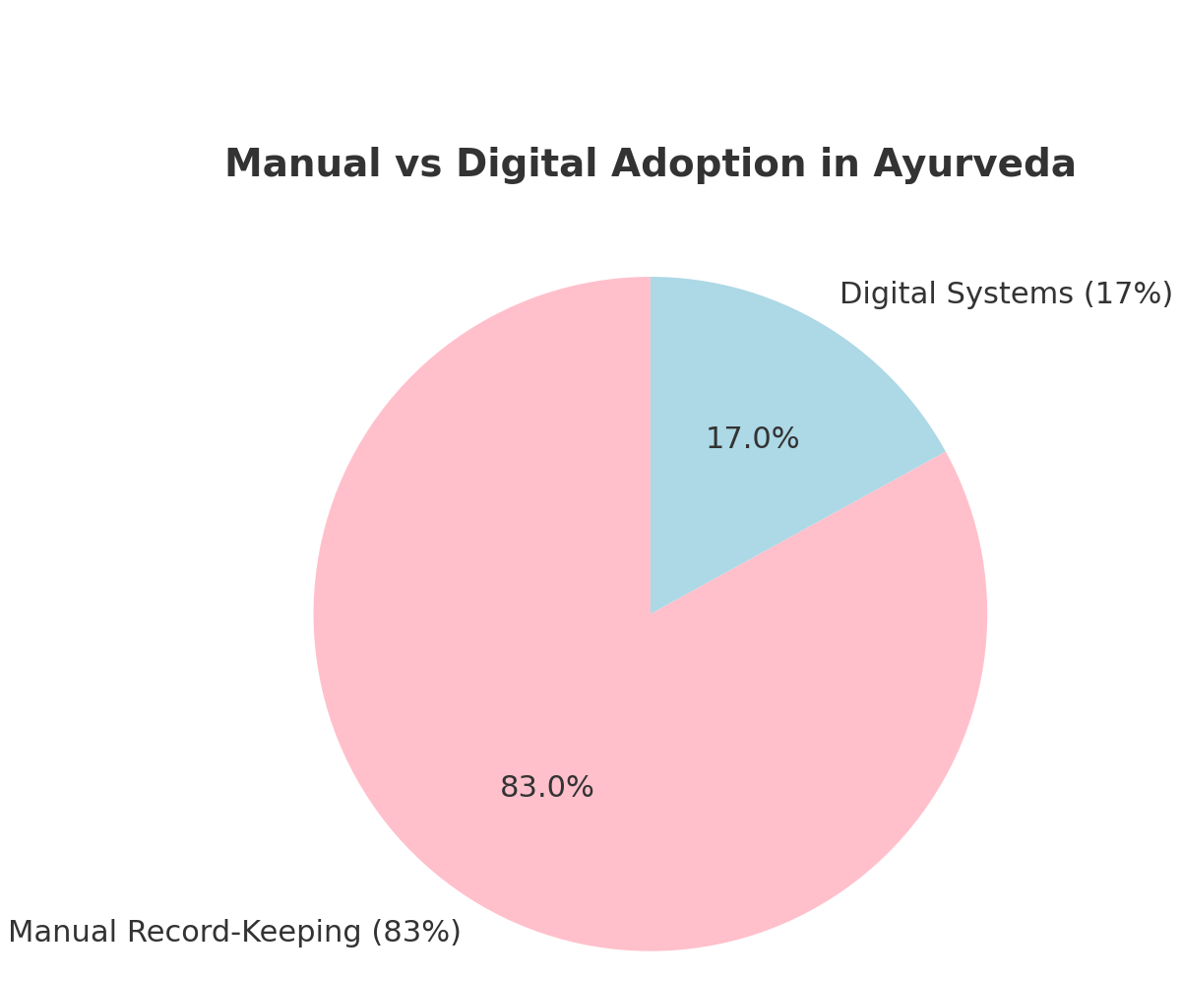
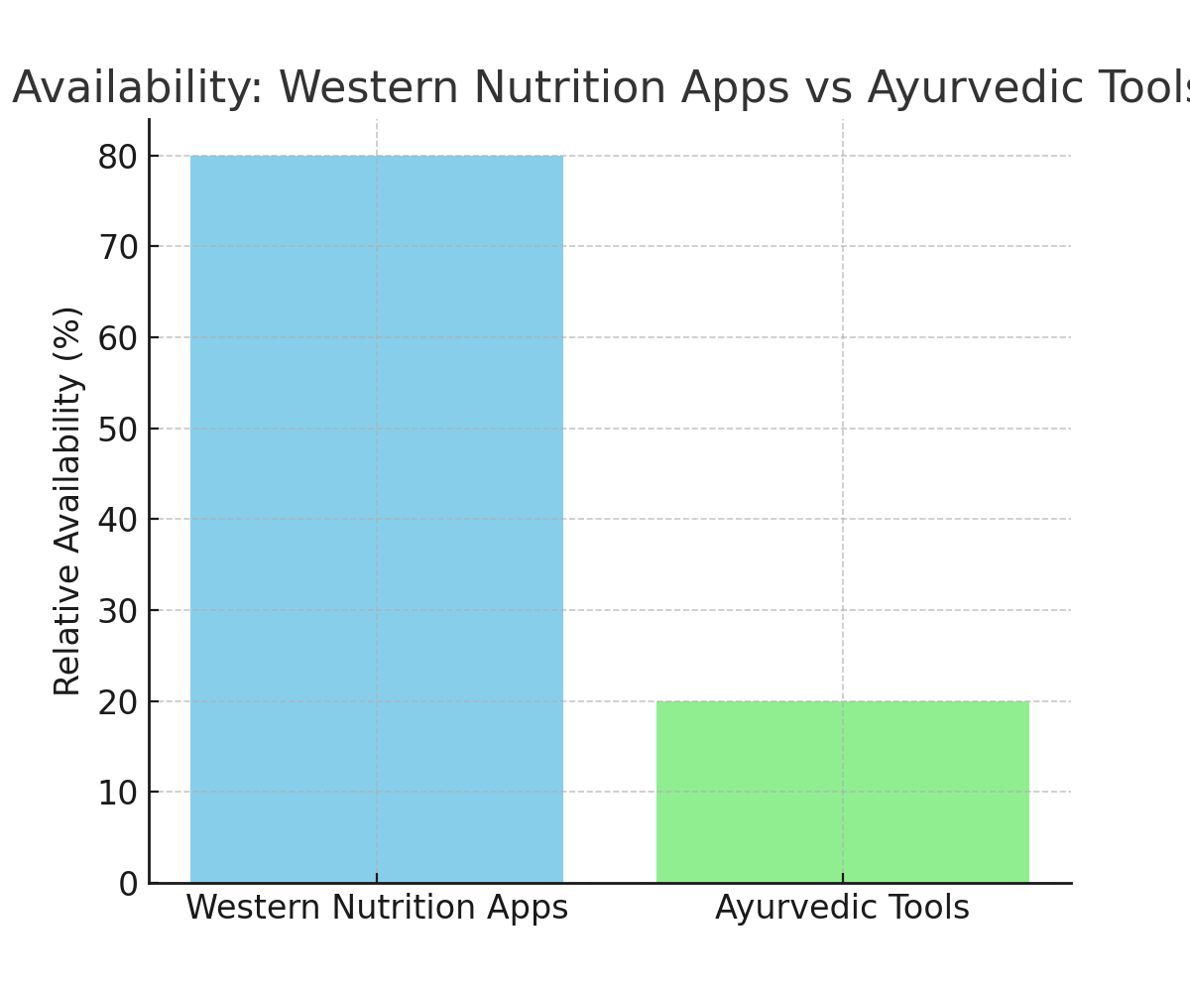
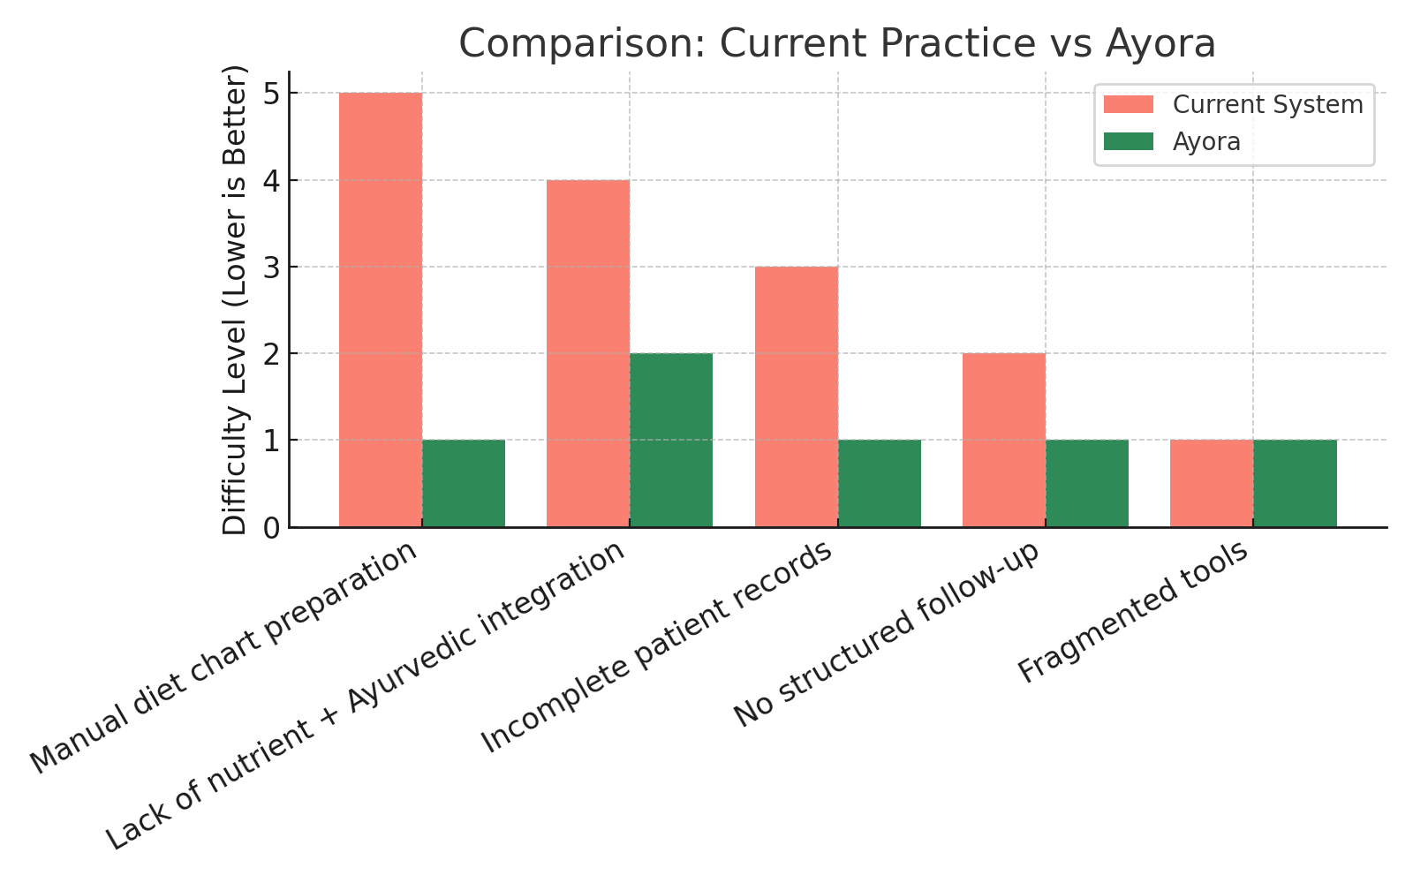
AYORA
Traditional healing, intelligent solutions—AYORA makes Ayurveda smarter.
NOVASTRA
Current Digital Solutions
Our Solution: Ayora
The Problem
83% practitioners still rely on manual records.
Fragmented tools → inefficiency & poor continuity.
Unified AI-powered Ayurvedic platform.
Hyper-personalized, scalable, future-ready.
Limited apps (only diet OR consultation).
No holistic personalization (prakriti + nutrition).

Slide 3
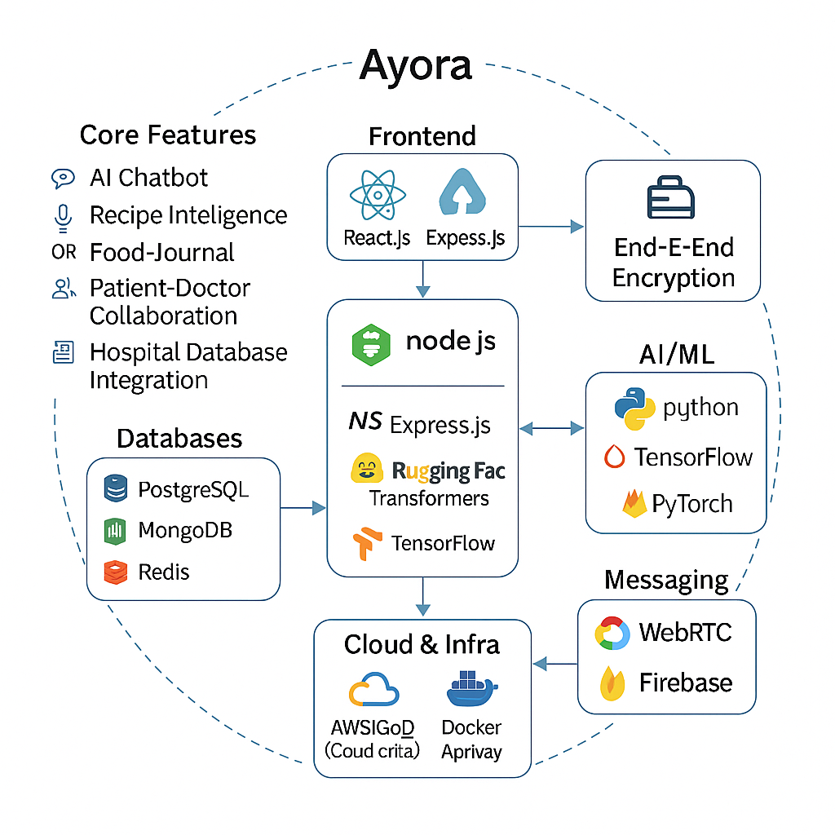
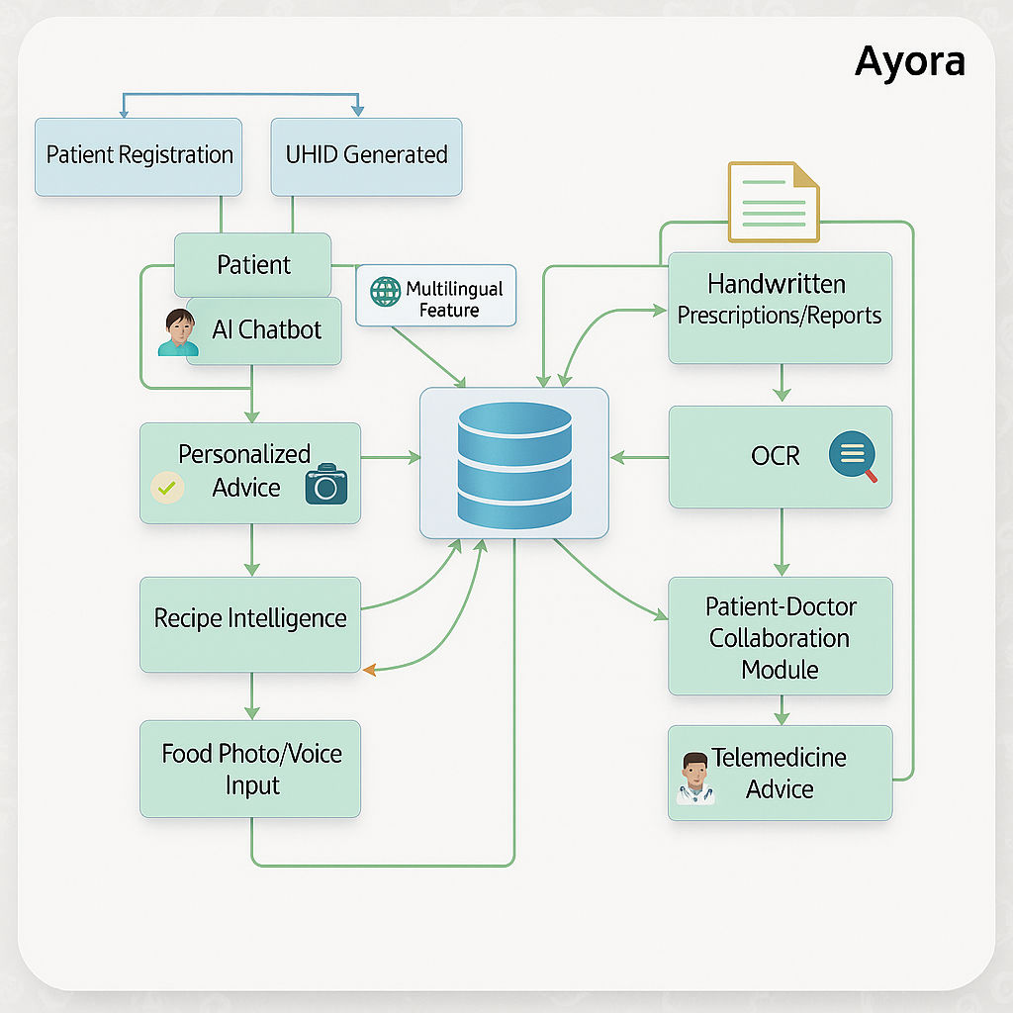
TECHNICAL APPROACH
NOVASTRA

Slide 4
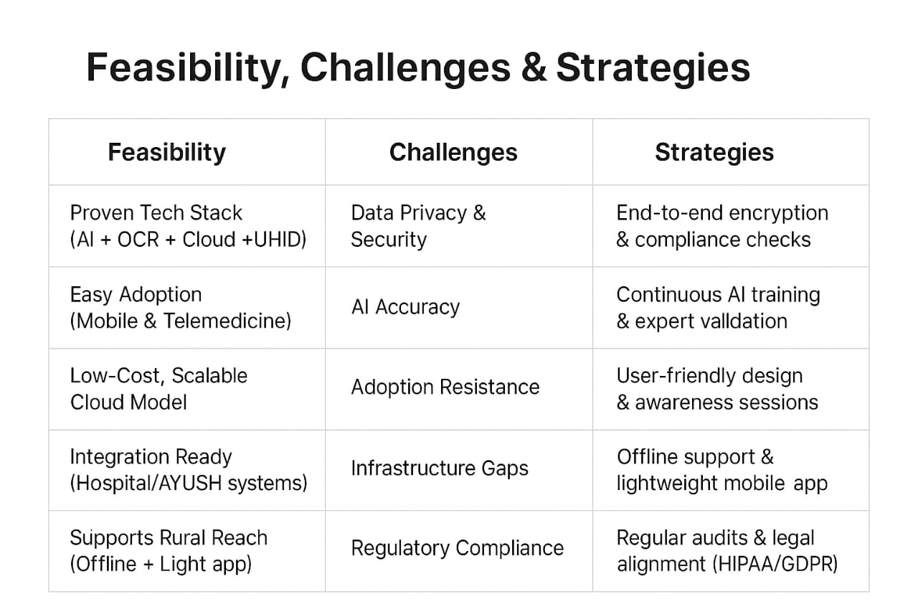
FEASIBILITY AND VIABILITY
NOVASTRA

Slide 5
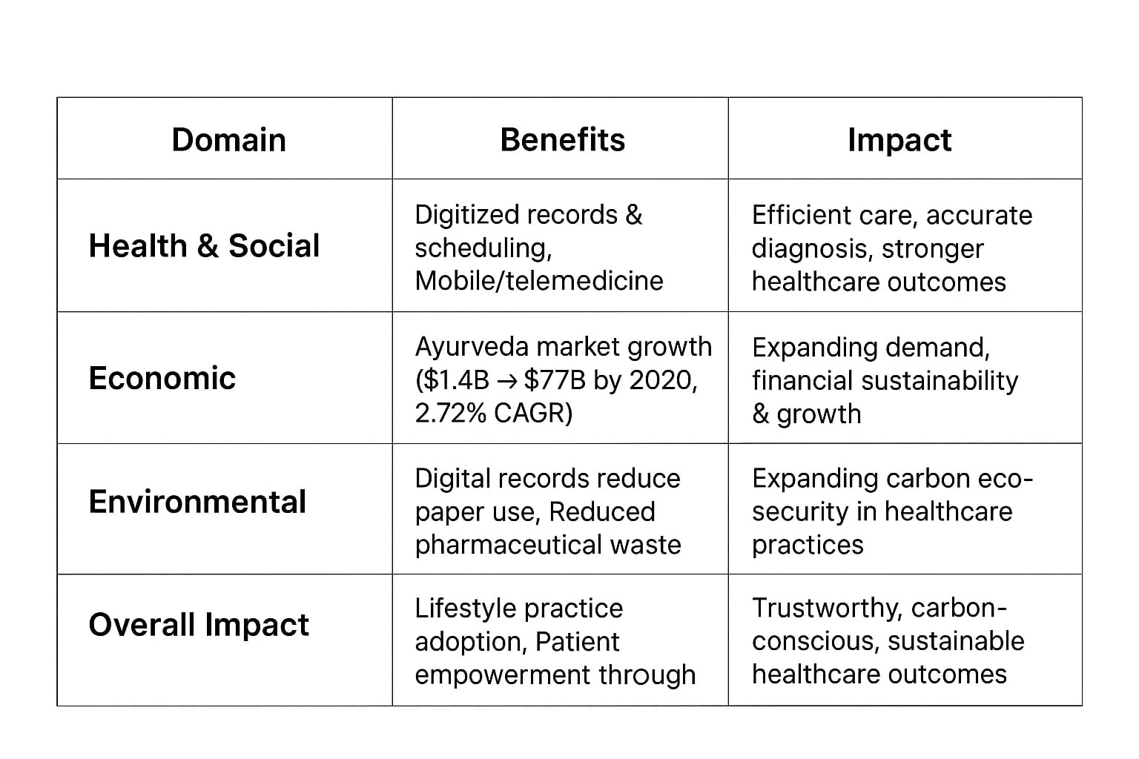
IMPACT AND BENEFITS
NOVASTRA

Slide 6
RESEARCH AND REFERENCES
NOVASTRA
PMC India: Artificial Intelligence Applications to Personalized Dietary Recommendations
https://pmc.ncbi.nlm.nih.gov/articles/PMC12193492
IJFANS: Smart Diet India—An AI-powered Platform for Personalized Nutrition
https://www.ijfans.org/uploads/paper/3c48c71e0f45809131056d48ba9b9745.pdf
Journal of Ayurveda & Holistic Medicine: AI-powered OCR Models for Digitizing Ayurveda
https://jahm.co.in/index.php/jahm/article/view/1467
npj Digital Medicine: India’s Evolving Digital Health Strategy.
https://www.nature.com/articles/s41746-024-01279-2
PIB India: Transforming Healthcare Through Digital Collaboration
https://www.pib.gov.in/PressReleaseIframePage.aspx?PRID=2094604

Slide 7
IMPORTANT INSTRUCTIONS
Please ensure below pointers are met while submitting the Idea PPT:
Kindly keep the maximum slides limit up to six (6). ( Including the title slide)
Try to avoid paragraphs and post your idea in points /diagrams / Infographics /pictures
Keep your explanation precise and easy to understand
Idea should be unique and novel.
You can only use provided template for making the PPT without changing the idea details pointers (mentioned in previous slides).
You need to save the file in PDF and upload the same on portal. No PPT, Word Doc or any other format will be supported.
Note - You can delete this slide (Important Pointers) when you upload the details of your idea on SIH portal.

